Slide 1
Excellence in Engineering Since 1946

Slide 2
Strand Associates, Inc.® ( )
Wastewater Treatment Plant Facilities Planning Update
Village of Marathon City Utility Commission and Village Board
April 9, 2020

Slide 3
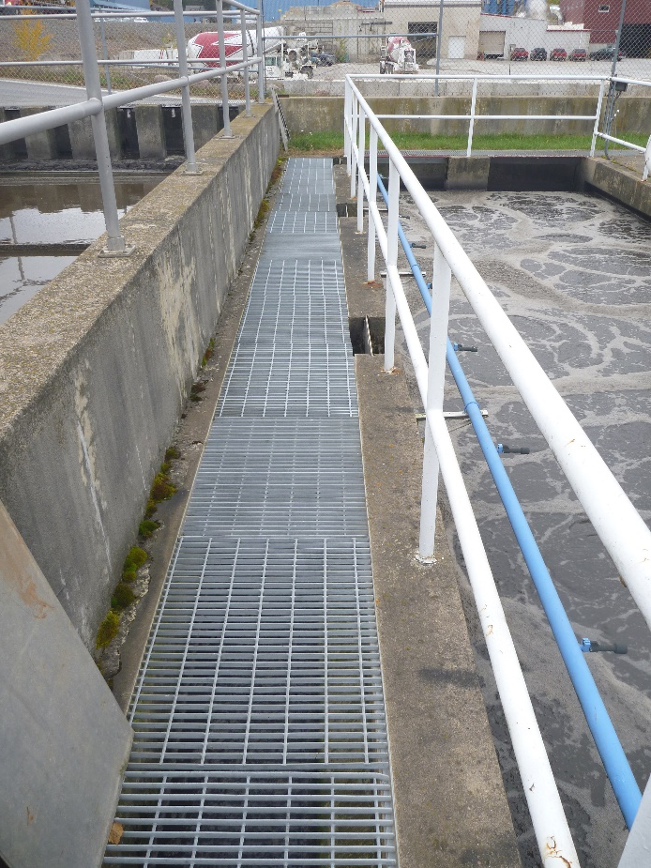
Presentation Outline
Background
Phosphorus Compliance
WDNR Compliance Agreement
Updated Facilities Plan
Why are These Improvements Needed?
Capacity of the Proposed Facilities
Treatment Alternatives
Recommended Plan
Other Options
Funding
Schedule

Slide 4
Background
2018
Regionalization
Evaluations
2016
Report
Identified P Plan;
Many unknowns
2012
WPDES Permit
P Compliance
Schedule
2019
WI River TMDL approved;
WDNR Compliance Agreement
2012
2014
2016
2018
2020
2010 to 2019
WI River TMDL
Ongoing
2020
MDV approval; WPDES Permit renewal
2014 to present
P compliance
alternatives change and evolve
2017
Multi-Discharger
Variance approved by EPA;
WPDES permit expired

Slide 5
Phosphorus Compliance 2020 Permit Reissuance TP Limit
DNR-projected P limit was 0.075 mg/L until TMDL was approved
 | Monthly Permit Limit or Equivalent (mg/L) | Annual lbs TP discharged | Reduction from Current Limit | TP lb Offset And Cost At $55/lb
Current plant | 1.0 | 792 | - | -
TMDL Current Scenario | 0.33 (6-month) | 260 | 67% | 530 lb $29,150
Add Tertiary filtration ~$2.7 million | To <0.2 | 158 | 80% | -
MDV (with watershed project) | 0.80 | 633 | 20% | 475 lb $26,125
TMDL SSC Scenario | 0.73* | 578 | 27% | 214 lb $11,770
Assumes 0.26 mgd average WWTP flow
As WWTP flows increase to design flow, concentration limits decrease to meet new TMDL mass limit.
*Chemical Phosphorus Removal (CPR) can be used to meet limit

Slide 6
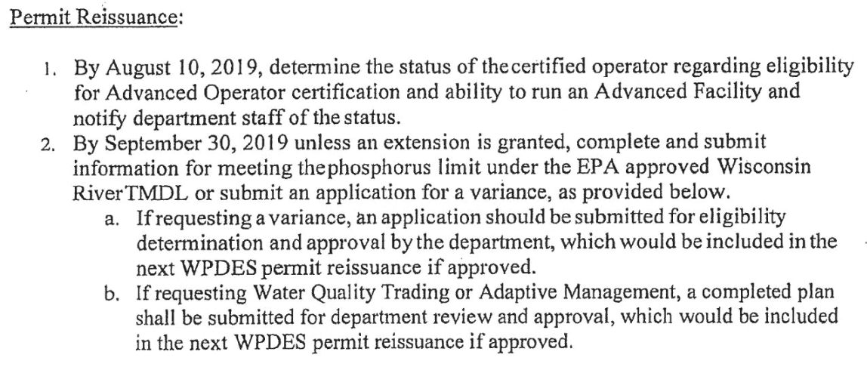
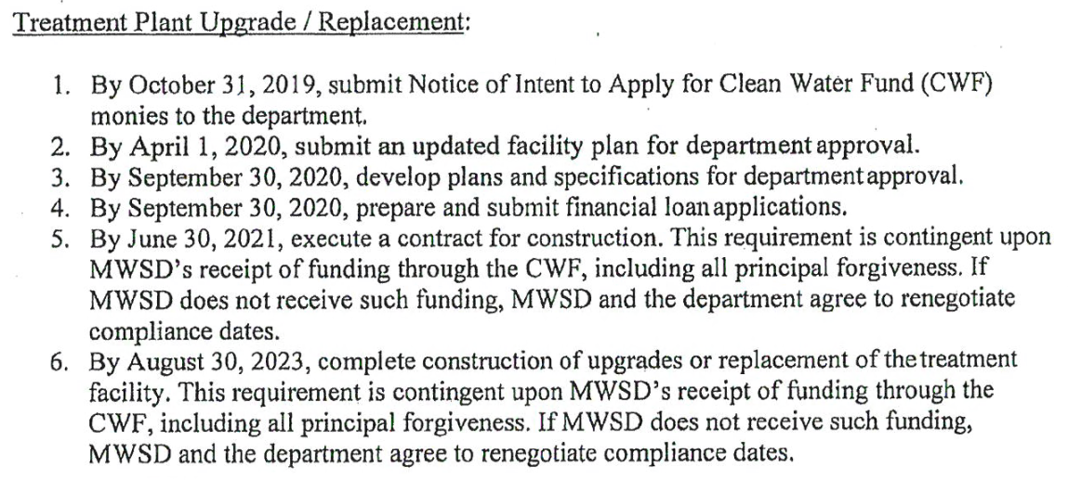
WDNR Compliance Agreement Schedule
(30 day extension granted)
Compliance Agreement was result of 4 Treatment Facility Overflows (TFOs)

Slide 7
Updated 2016 Facilities Plan
Develop a plan to provide wastewater treatment capacity for the Village’s existing urban service area through the year 2042 (20 years).
Identify alternatives that can be expanded to accommodate future growth beyond the year 2042.
Identify the most cost-effective alternative to implement in the limited site area with the least significant environmental impacts.
Updated report completed in 2016 with phosphorus compliance planning

Slide 8
Facility Plan Elements Address Equipment and Processes at the End of Their Useful Life
What You Have
Sections 1, 2, and 3
What You Need
Sections 4, 5, and 6
How Do We Get There?
Section 7
Collection system
Flows and loads
Regulatory requirements
Age/condition
Existing plant performance
Recommended Plan
Sections 8, 9, and 10
Implementation plan
Environmental impact summary
Alternatives evaluation
Public participation

Slide 9
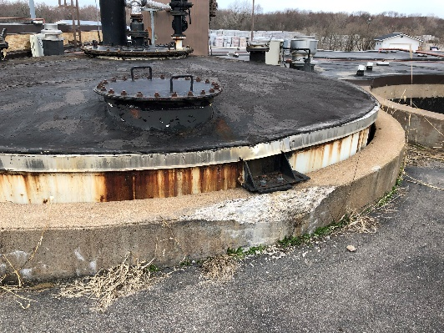
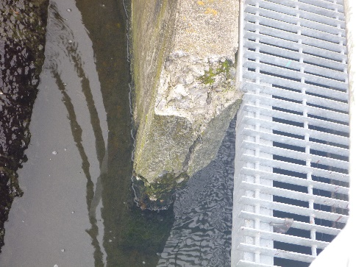
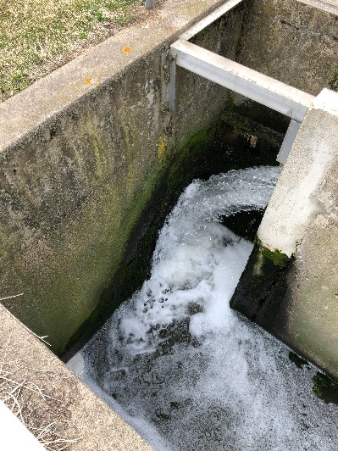
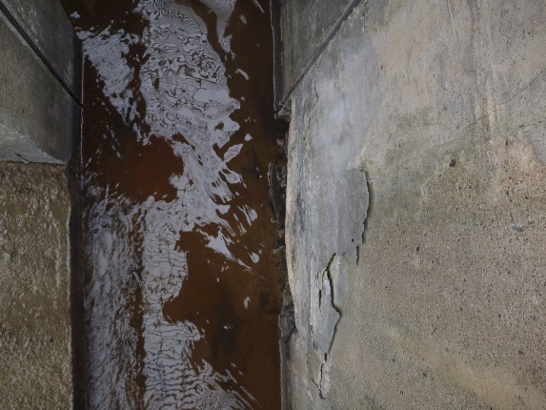
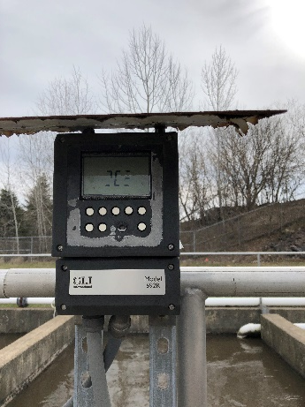
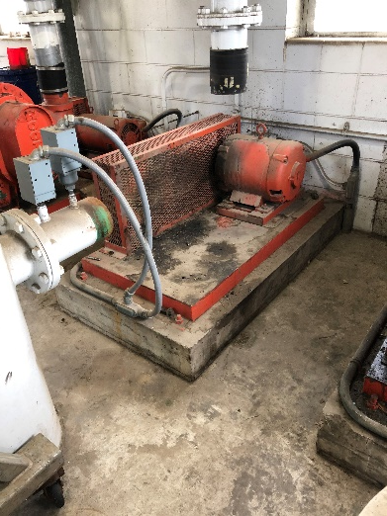
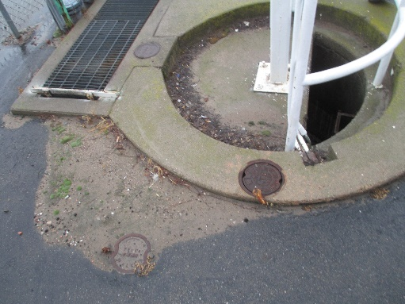
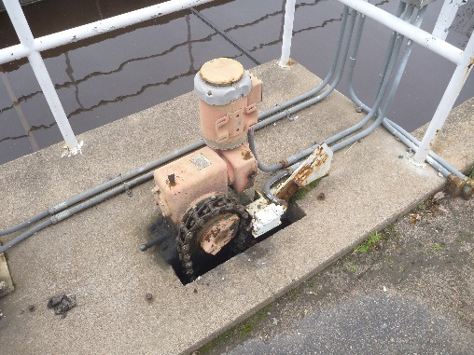
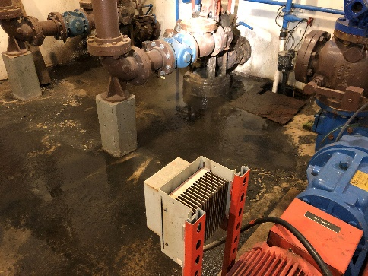
Why are These Improvements Needed?
Aging equipment/facilities and maintenance
Most of the current facilities were constructed in 1971 or 1999 (20-50 years old).

Slide 10
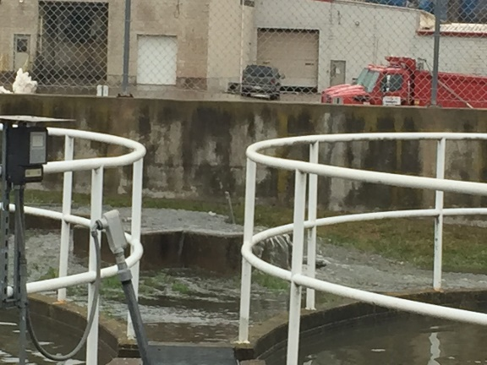
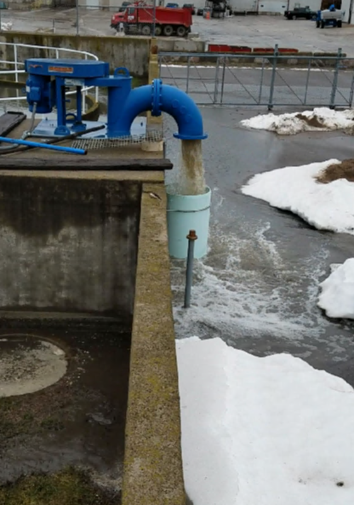
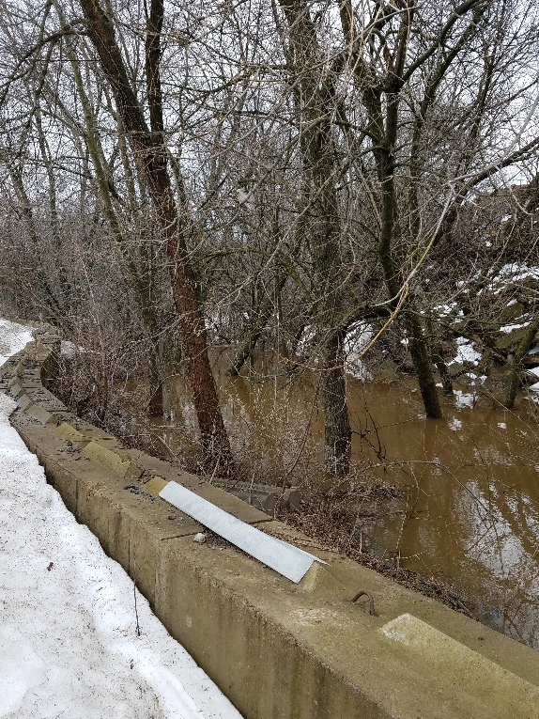
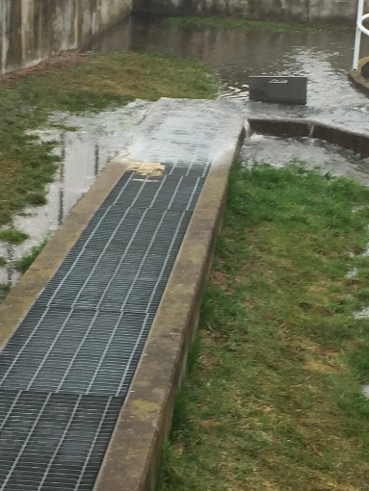
Why are These Improvements Needed?
Inadequate Hydraulic Capacity
Hydraulic bottlenecks in mixed liquor channel.
Final clarifiers are undersized.
Effluent pipe (12-inch) is undersized.

Slide 11
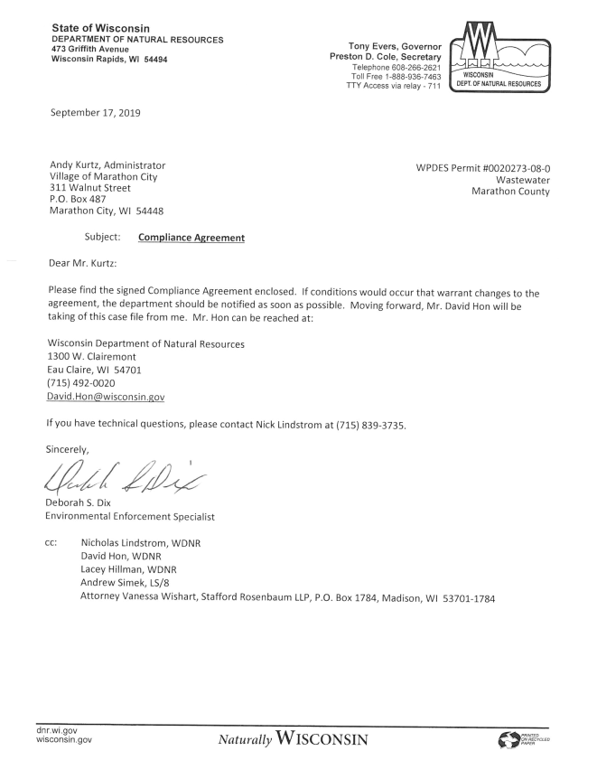
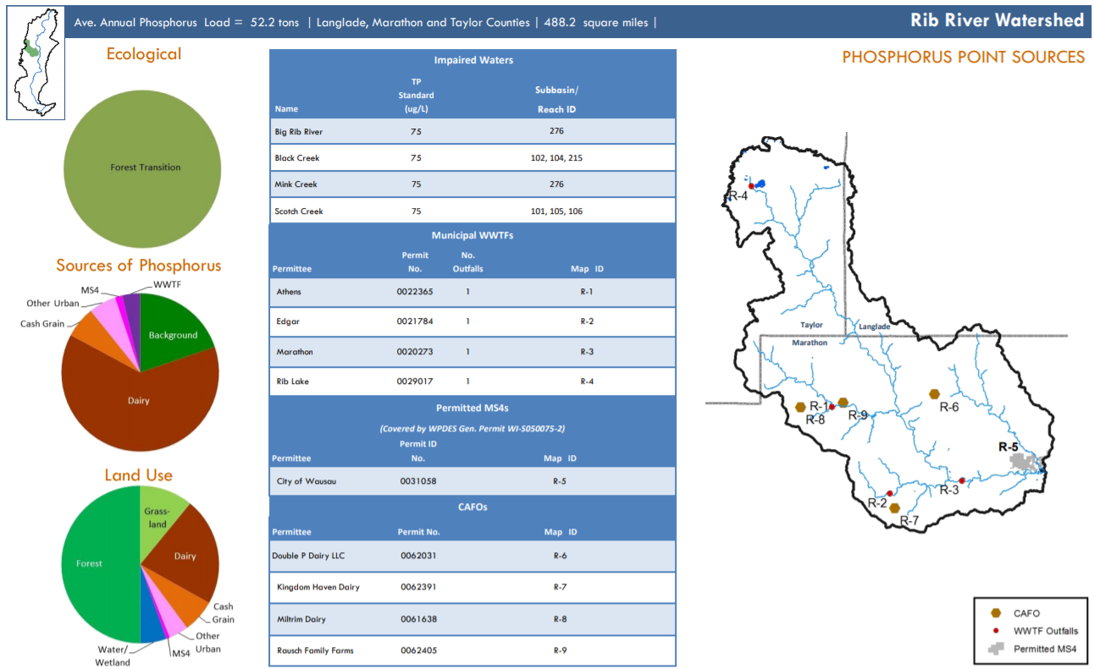
Why are These Improvements Needed?
Compliance issues
Treatment facility overflows and compliance agreement with WDNR.
Lower total phosphorus limit (1.0 mg/L or 1,065 lb/yr to 393 lb/yr TMDL)

Slide 12
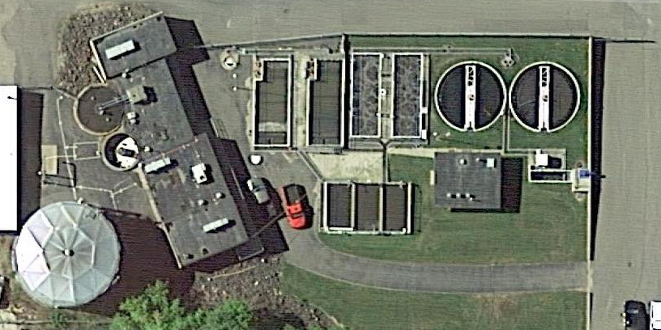
Existing Facilities Have Served Village Well
Screening and Grit Removal 1999
Control Building
1971
Primary Clarifier 1999
Final Clarifiers 1971
Digester 1971
Aeration Tanks 1971
Digester before 1971
Primary Clarifier 1971
BPR Tanks 1999
Blower Building
1971
Chlorine Contact Tank 1971
UV Disinfection
1999
Sludge Storage Tank 1999
Control Building Addition
1999

Slide 13
What is the Capacity of the Proposed Facilities?
Item | Current Design | Design Year 2042 | 2042 with MC Expansion
Daily Average Flow, mgd | 0.35 | 0.36 | 0.36
Peak Hourly Flow, mgd | 1.63 | 2.20 | 2.20
BOD, lbs/day | 627 | 585 | 627
TSS, lbs/day | 630 | 470 | 492
TP, lbs/day | 15 | 18 | 20
Note: Marathon Cheese data is preliminary.

Slide 14
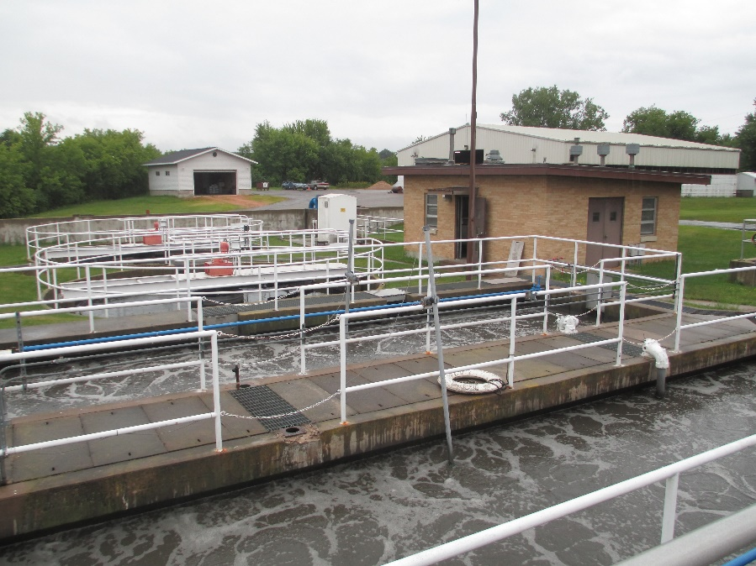
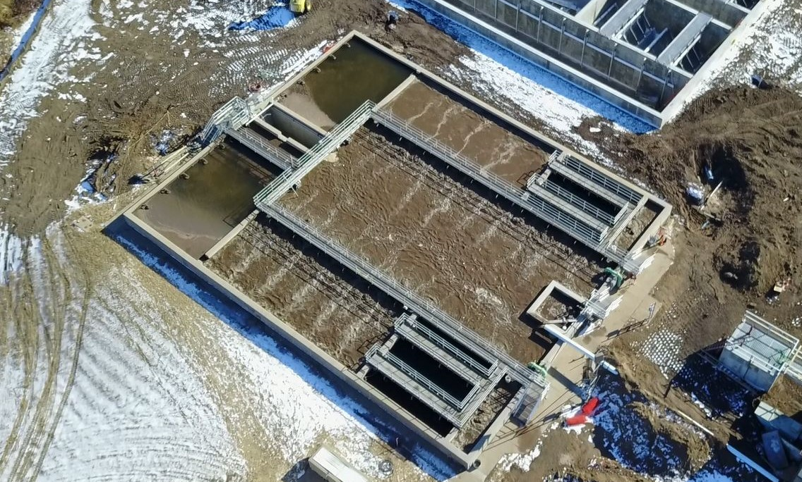
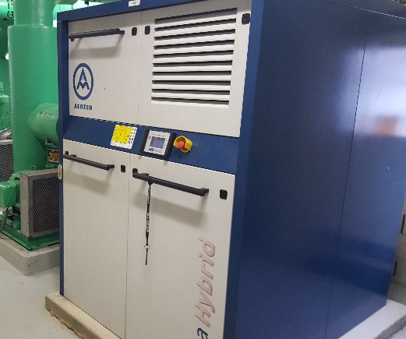
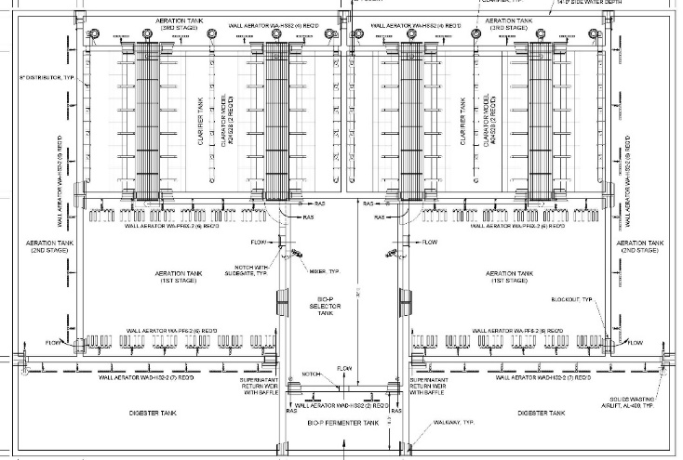
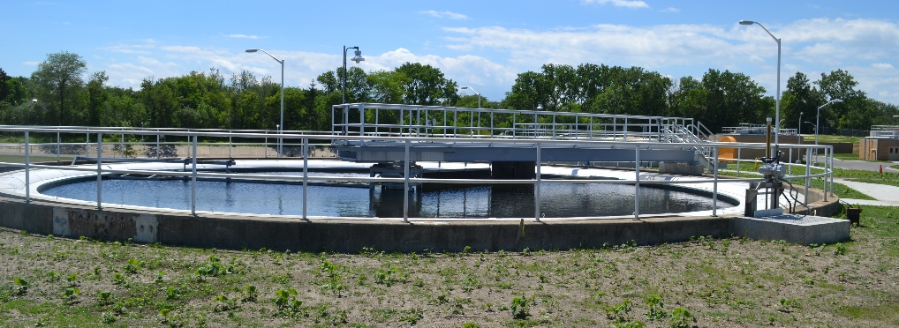
Two Biological Treatment Alternatives
WWTP-1 Renovation of Existing Facilities, New Final Clarifiers
WWTP-2 Aero-Mod Treatment Unit
Both alternatives include BPR and two clarifiers
WWTP -2
WWTP -1

Slide 15
Two Biological Treatment Alternatives Evaluated WWTP 1 – Existing Plant Upgrade
Biological Treatment Alternatives
Common Item
Effluent to Outfall
Common Item
Influent
Preliminary Treatment
Primary
Clarification
Biological Treatment with BPR
Final Clarification
Disinfection
Common Item
RAS
WAS
Biosolids Storage
Biosolids Digestion
Biosolids
Thickening
Chemical Phosphorus Removal
Common Items
Common Item
Land Application

Slide 16
Two Biological Treatment Alternatives Evaluated WWTP 2 – Aeromod Plant and Common Plant Upgrades
Biological Treatment Alternatives
Common Item
Effluent to Outfall
Common Item
WWTP-2
AEROMOD:
Final Clarification and Aerobic Digestion
Influent
Preliminary Treatment
Influent Pumping
Biological Treatment/BPR
Disinfection
Common Item
RAS
WAS
Biosolids
Thickening
Chemical Phosphorus Removal
Common Item
Biosolids Storage
Common Items
Land Application

Slide 17
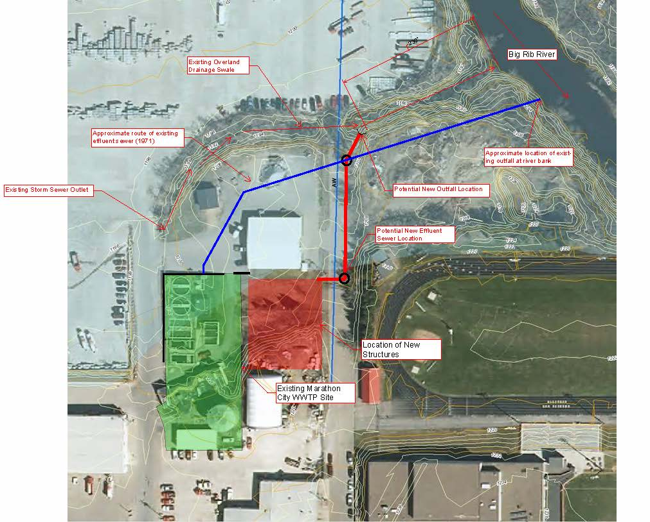
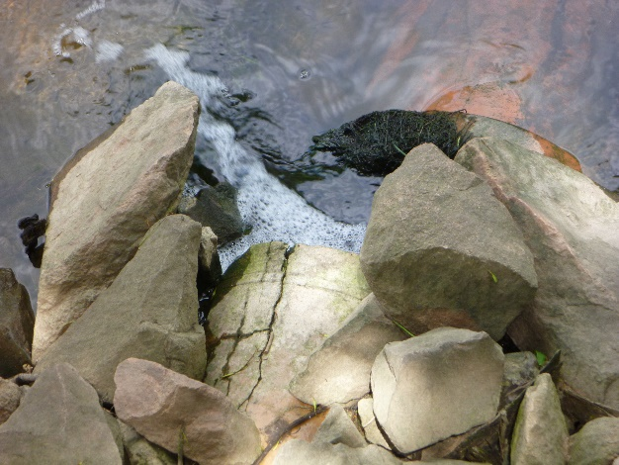
Outfall Modifications Included – Location Request to DNR

Slide 18
Biological Treatment Alternatives – Opinion of Capital Costs
Alternative | Description | Capital Cost
WWTP-1 | New Blowers, Diffusers, Clarifiers | $7,349,000
WWTP-2 | Aero-Mod Treatment Unit, New Blowers | $6,047,000
Note: Does not include cost for common items of $1,694,000.
Includes Contingencies and Engineering.

Slide 19
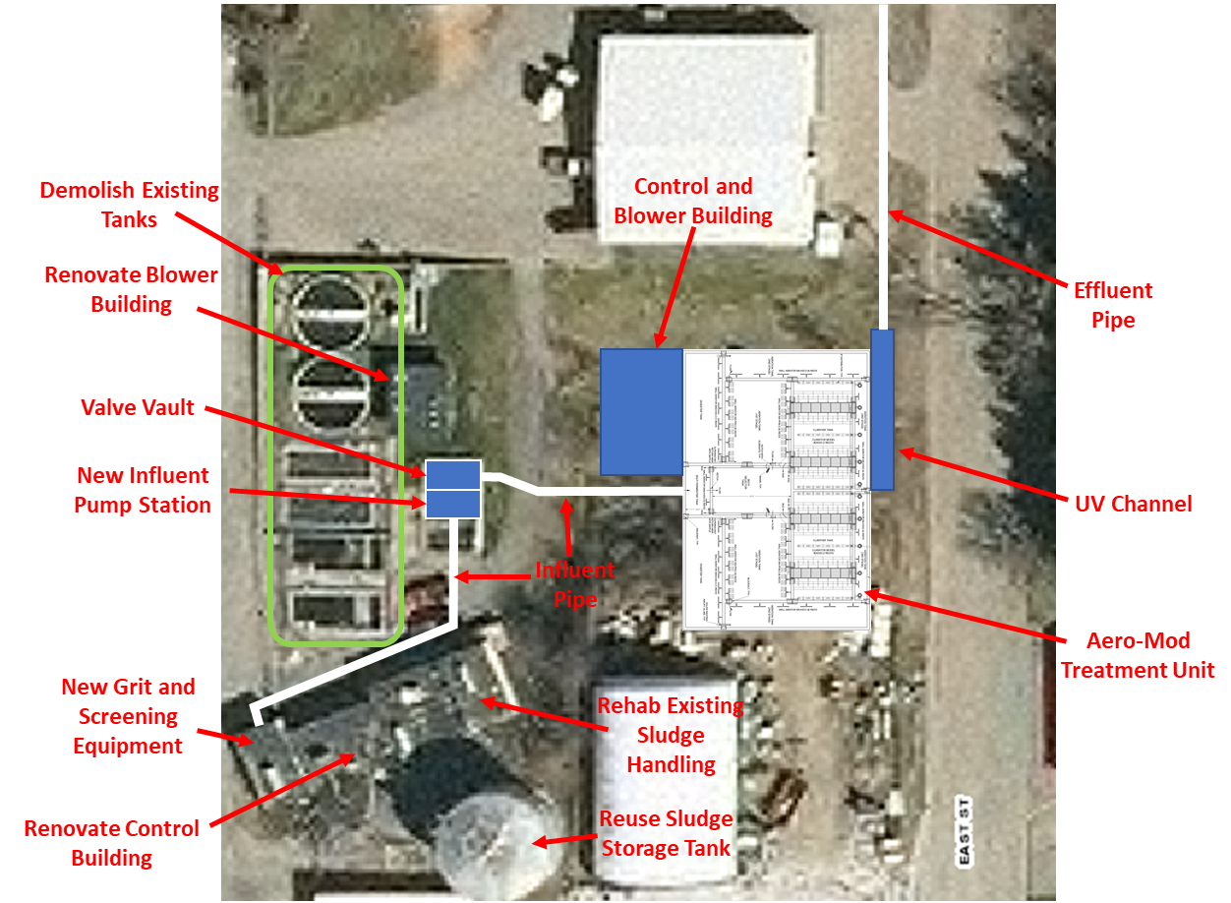
Recommended Plan Proposed Improvements – WWTP-2
Source: Marathon County GIS

Slide 20
Opinion of Capital Costs
Item | Cost
Influent Screening | $239,000
Screening Room Improvements | $42,000
Grit Removal | $99,000
Influent and Effluent Samplers | $18,000
New Effluent Pipe, Outfall | $87,000
Scum and Drain Pumps | $39,000
Sludge Thickening | $27,000
GBT Feed Pump, TWAS Pumps, WAS Tank Aeration | $111,000
Plant Water System | $57,000
Control Building | $181,000
SCADA-Software, PCs, Lift Station and Water System | $200,000
Aero-Mod Equipment | $992,000
Installation | $205,000
Concrete | $935,000
Excavation and site work | $269,000
Demolition | $200,000
Influent Pumping | $225,000
Chemical Phosphorus Removal | $162,000
Digested Sludge Pumps | $42,000
Disinfection | $246,000
New Control and Blower Building | $195,000
Mechanical | $128,000
Electrical | $327,000
Subtotal | $5,026,000
Contractor GCs (10%) | $503,000
Subtotal Construction Cost Opinion | $5,529,000
Contingencies (25%) and Engineering Services (15%) | $2,212,000
Total Capital Costs | $7,741,000
Common
Elements
WWTP-2

Slide 21
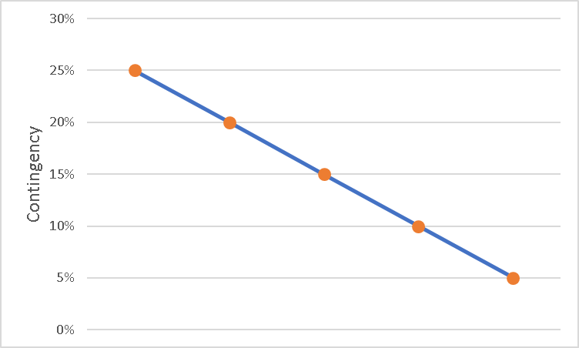
Contingency Amount Decreases as Definition of Project Increases
Facility Planning
60% Design
90% Design
Bidding
Increasing Project Definition
Construction

Slide 22
Financial Overview – Wastewater Facilities Plan
Item | Cost with ~96% Parallel Cost
Opinion of Total Project Cost | $7,741,000
CWF Principal Forgiveness Amount | ($858,000)
Parallel Cost Contribution – Marathon Cheese (est) | ($310,000)
Resultant Loan Amount | $6,573,000
Projected Loan Rate (pending market changes) | 1.65%
Estimated Annual Debt Service Payment | $388,500
Debt Coverage Ratio | $39,000
Existing Sewer Utility Revenues | $416,000
Anticipated Reduction in Operating Expenses* | ($30,000)
Debt Retirement | ($124,000)
Future Utility Expenditures with New Debt and Operating Expenses | $689,500
Required Increase in Sewer Utility Revenue** | 66%
*Conservative estimate; savings could be greater for less NG use, less maintenance, fewer components for replacement/repair, etc.
**Rate increase may be phased in until loan repayment starts.

Slide 23
Other Options – Phasing Project Aero-Mod Option not Practical with Phased Approach Phasing for WWTP-1 Alternative:
Scenario 1 – Fulfill DNR Compliance Agreement + SCADA
Concept requires vetting with DNR
Probable Three-Phase Approach
Phase 1 cost = ~$1.1 million
Scenario 2 – “2-year solution”
Comply with DNR, fix short-list of highest priority issues
Two or three-phase approach
Phase 1 cost = ~$2.7 million, second project in ~5 years
Full review with Village needed
Scenario 3 – “5-year solution”
Comply with DNR, fix longer list of high priority issues
Probable two-phase approach
Phase 1 cost = ~$5.1 million
Full review with Village needed

Slide 24
Phased Project Considerations and Risks
Costs of two projects always greater than one project
Inefficiencies from duplicated efforts in design, construction management, and permitting
Double bidding effort
Contractor’s mobilization and other general conditions
Inflation of building material and labor costs
Continued maintenance of old equipment
Increased potential for failures, permit violations
Potential for higher interest rates
Potential for loss of principal forgiveness, stimulus funding
Not replacing as much of facility as WWTP-2 alternative
Increased maintenance and potential for failures in remaining infrastructure

Slide 25
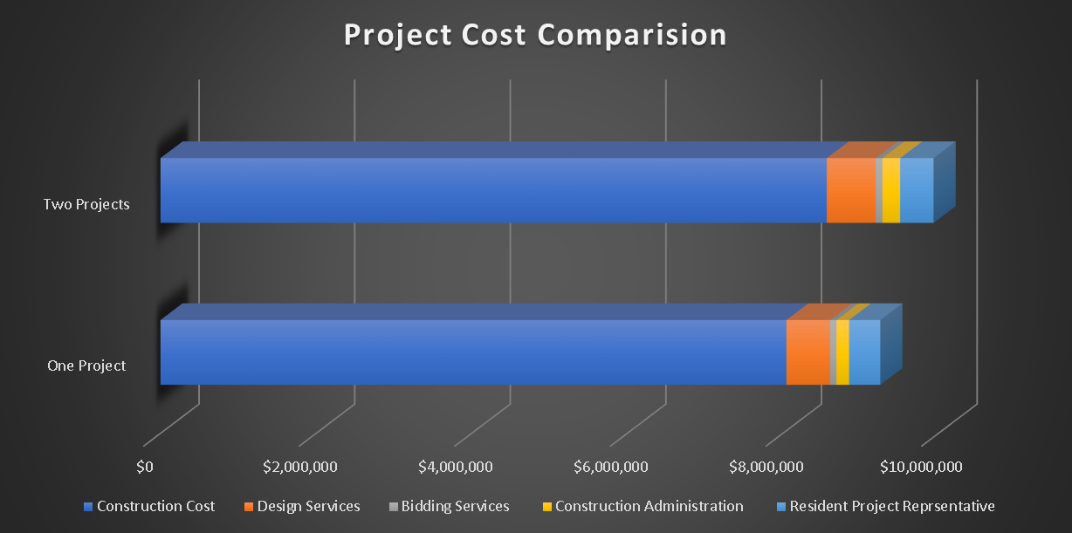
Phasing is Possible, but Results in Higher Total Project Costs
WWTP-1 Alternative:
Estimated Combined Construction Cost = ~$9,900,000
Estimated Construction Cost = ~$9,000,000

Slide 26
Funding Options Will be Identified to Minimize Costs to Ratepayers
Clean Water Fund
Low interest loans – 1.65%, 20 year term
Grants – Principal Forgiveness, General and Phosphorus Reduction
Regular PF - 15% project costs up to $750,000
Phosphorus PF – 50% of parallel cost up to $1 million
ITA and PERF have been filed; Project is on funding Priority List
Potential Stimulus funds via COVID-19 stimulus, On Project List
USDA Rural Development (Population < 10,000)
Low interest loan; loan only rate 2.75%, term variable
Grants – MHI < state MHI to qualify
Village MHI $59,028 > state MHI $56,439 (census data)
Percentage of MHI:
CWF State Fiscal Year (SFY) 2021 MHI for Marathon City = $58,516
CWF SFY 2021 MHI for Wisconsin = $56,759
For CWF hardship, MHI < 80% state MHI required
Rate is 1.1% - 1.2% of MHI vs. 2.0% required for WDNR economic hardship variance

Slide 27
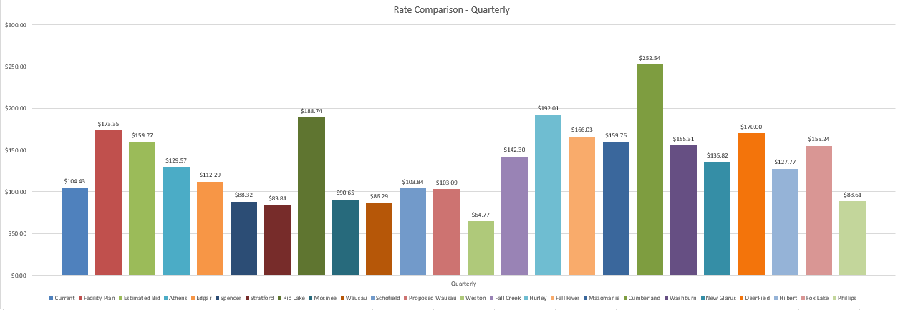
Sewer Rate Impact
Sewer Rates (Residential):

Slide 28
Schedule That Includes No Phasing
Task | Schedule Date
Hold Public Hearing on Facilities Plan | TBD
Submit Facilities Plan to WDNR per Compliance Agrmt | After Public Hearing
Begin Design | After Public Hearing
Additional Soil Borings and Survey if needed | After Public Hearing
Submit Drawings and Specifications to WDNR | September 30, 2021
Submit CWFP Loan Application | September 30, 2021
WDNR Plan and Specification Approval | Est December 2021
WDNR Funding List | Est December 2021
Project Bid Date | January 2022
Begin Construction | April 2022
Construction Completion (Projected) | August 30, 2023
Construction Completion (Compliance Agreement) | August 30, 2023

Slide 30
Excellence in Engineering Since 1946

